Slide 1


Vehicle Damage Detection
NATIONAL INSTITUTE OF BUSINESS MANAGEMENT
HDSE 22.1F
Digital Image Processing
Assignment – 4
Group Project

Slide 2

ABOUT TOPIC
The unexpectedly increasing vehicle industry particularly backs the equally speedy-developing vehicle coverage market. Despite the fact that until now this enterprise has been totally based on conventional ways to make repair claims. In case of an unlucky coincidence, the claims for the car harm needs to be filed manually. An inspector is required to physically examine the motors to assess the damage and obtain a value estimate. In such scenario, there's also the possibility of misguided settlements due to human mistakes. Automating one of these technique with the help of gadget getting to know and faraway utilization might make the method lots greater handy for each facets of the harm, increasing productiveness of the coverage carrier and satisfaction of the patron.
At the same time as the technology is but to reap the highest viable stages of accuracy, above is an evidence of concept of the software of Deep learning and computer imaginative and prescient into automating the damage exams by constructing and education Convolution Neural Networks.
Presenter : KUHDSE22.1F-003

Slide 3
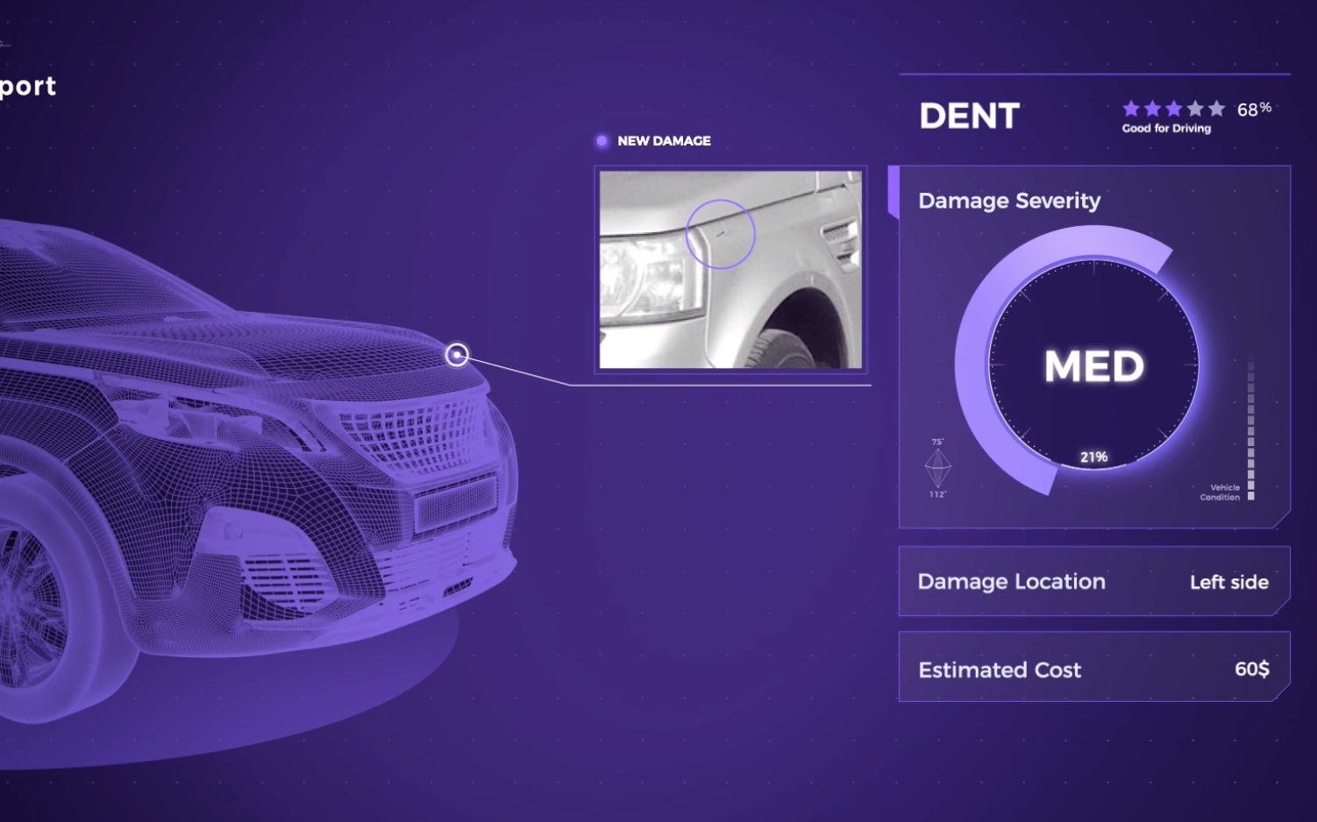
MODEL ARCHITECTURE
Our system architecture is built around the following modules:
User Input: User submits image containing the damage.
Gate 1: Checks to ensure the submitted image contains a car.
Gate 2: Checks to ensure the submitted image of car is damaged avoiding fraudulent claims.
Location Assessment: Tests image against the pre-trained model to locate damage
Severity Assessment: Tests image against pre-trained models to determine the severity of damage.
Results: The results are sent back to the user and third party
Presenter : KUHDSE22.1F-003

Slide 4
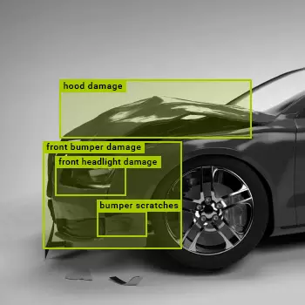
SOLUTION
To automate this kind of machine, the perfect method would be to construct a Convolution Neural network version able to accepting pics from the user and figuring out the location and severity of the harm. The model is required to skip via a couple of checks that might first make certain that given photo is that of a automobile and then to make certain that it is in reality damaged. These are the gate exams before the evaluation begins. As soon as all of the gate tests have been verified, the damage take a look at will commence. The model will expect the area of the damage as in front, facet or rear, and the severity of any such harm as in minor, moderate or severe.
Presenter : KUHDSE22.1F-010

Slide 5
SOLUTION
The model accepts an enter picture from the user and processes it across 4 ranges:
1. Validates that given photo is of an automobile.
2. Validates that the auto is broken.
3. Reveals location of harm as the front, rear or aspect
4. Determines severity of damage as minor, mild or intense
The Version can be imported similarly:
1. Achieve a value estimate
2. Ship assessment to insurance carrier
3. Print documentation
Presenter : KUHDSE22.1F-010

Slide 6
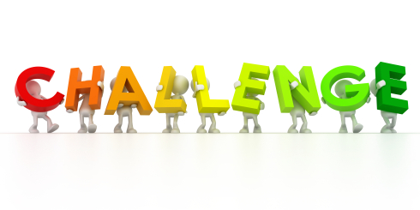
CHALLENGES
The field of Computer Vision is yet developing and not mature enough to deal with modular phone camera quality images. Angle, lighting, resolution are factors that can easily cause major disruptions in image classification.
Car insurance settlement claims require near perfect accuracy to ensure the customer is not frauded in the process. Such models would be required to be trained on humongous datasets which are highly difficult to procure.
To run such heavy datasets to ensure maximum accuracy would be imposed by hardware restriction. Storing, training and deploying such heavy datasets over the cloud would require expensive architecture.
While the computer can avoid human errors, there are often situation that would require such a model to flag for human assistance.
Presenter : KUHDSE22.1F-020

Slide 7

CHALLENGES
Systems running on the Cloud, especially those dealing monetary data are also heavily susceptible to cyber risks and require heavily structured frameworks to ensure customer data security.
Such a process will require a certain level of manual control and filter to avoid flooding of fraudulent insurance claims.
Presenter : KUHDSE22.1F-020

Slide 8
IMPROVEMENT
The data set used in this application consisted of around 1500 images for the first gate check, while the classification models were trained on only 400 images per class, while the validation dataset had approximately 75 to 100 images each class. Such a model will have low accuracy.
With a wider range of data set featuring multiple components of the car, the model can also be trained to identify what components are damaged, also classifying the varying degree of damage of each.
With a highly expansive dataset containing the make, model, year of the car and the possible cost estimates for the varying degrees of damage, the model can also predict the value for the user, before he submits the more advanced and detailed assessment for evaluation.
Presenter : KUHDSE22.1F-003/KUHDSE22.1F-020

Slide 9
IMPROVEMENT
Using more secure and durable hardware, the entire system can be built on the Cloud to run remotely and from the user’s cellular device itself.
The application can also be updated to recommend the user of policies pertaining to the specific accounts and other insurance benefits.
Presenter : KUHDSE22.1F-010

Slide 10
PROJECT LINK
Google Colaboratory
https://colab.research.google.com/drive/1OEozPhL3l5IxWyWyByYejkEHO8g-YyHI?usp=sharing

Slide 11


Slide 12

Team Members:
KUHDSE22.1F-003 : Sahan Silva
KUHDSE22.1F-010 : Sandushi Umayanga Dissanayake
KUHDSE22.1F-011 : Kavishka Vishwani Rathnapala
KUHDSE22.1F-020 : Bawantha De Silva

